Slide 1

Modular Synth
TMR-21

Slide 2
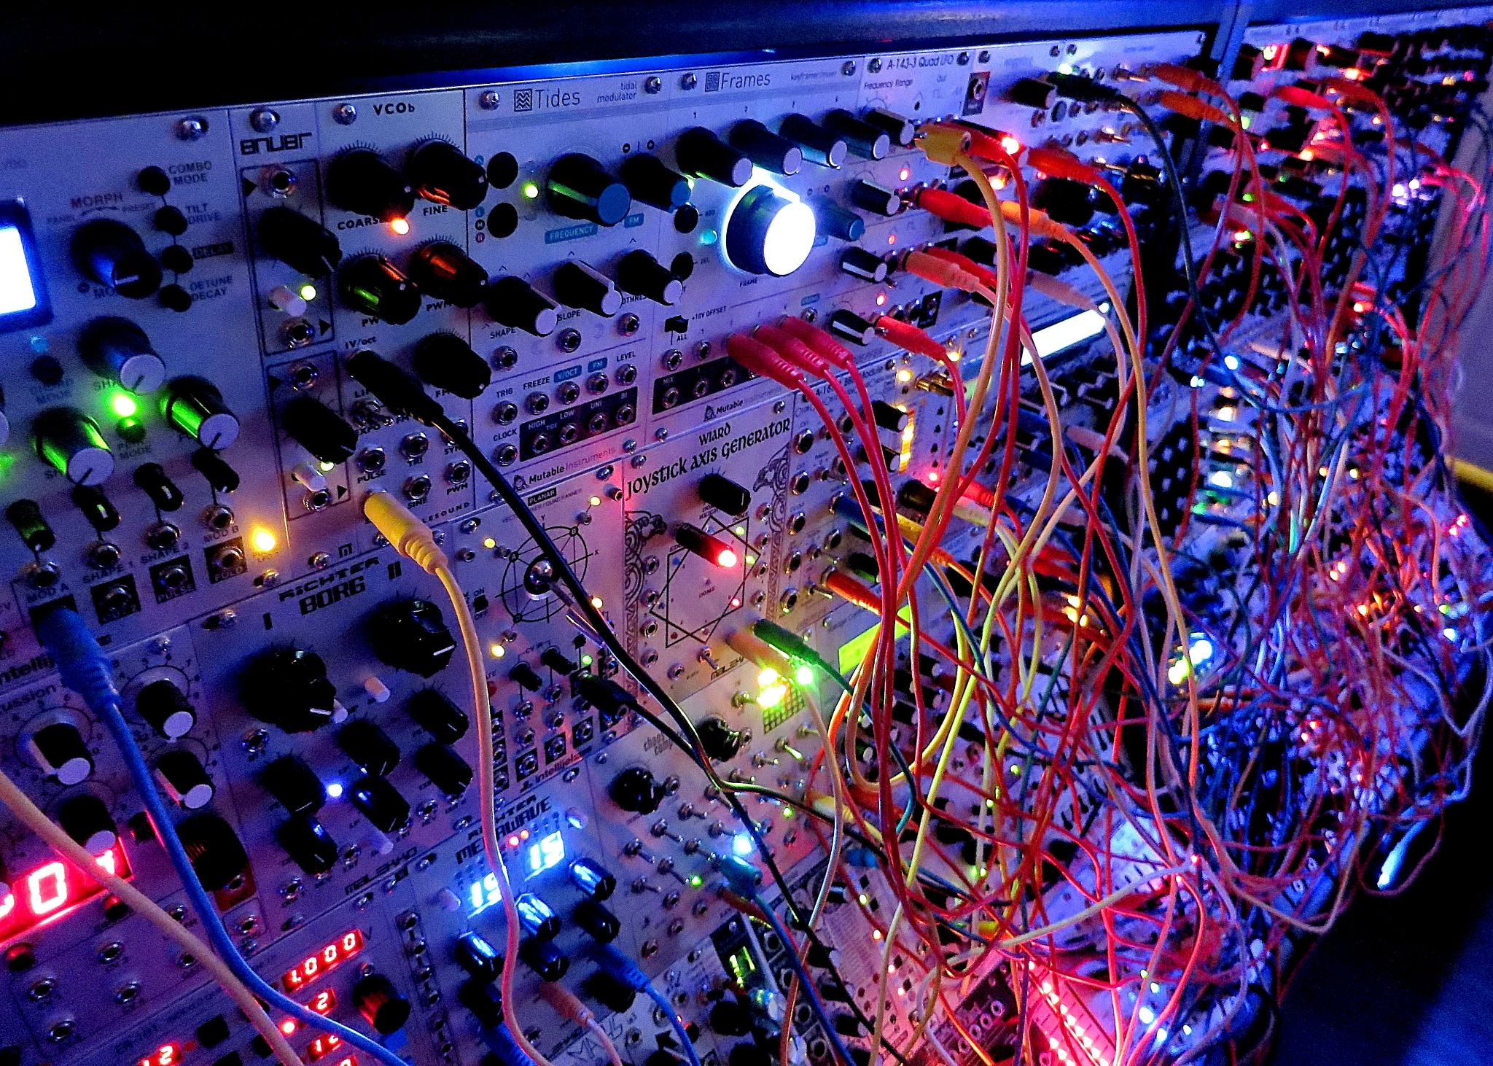

Slide 3

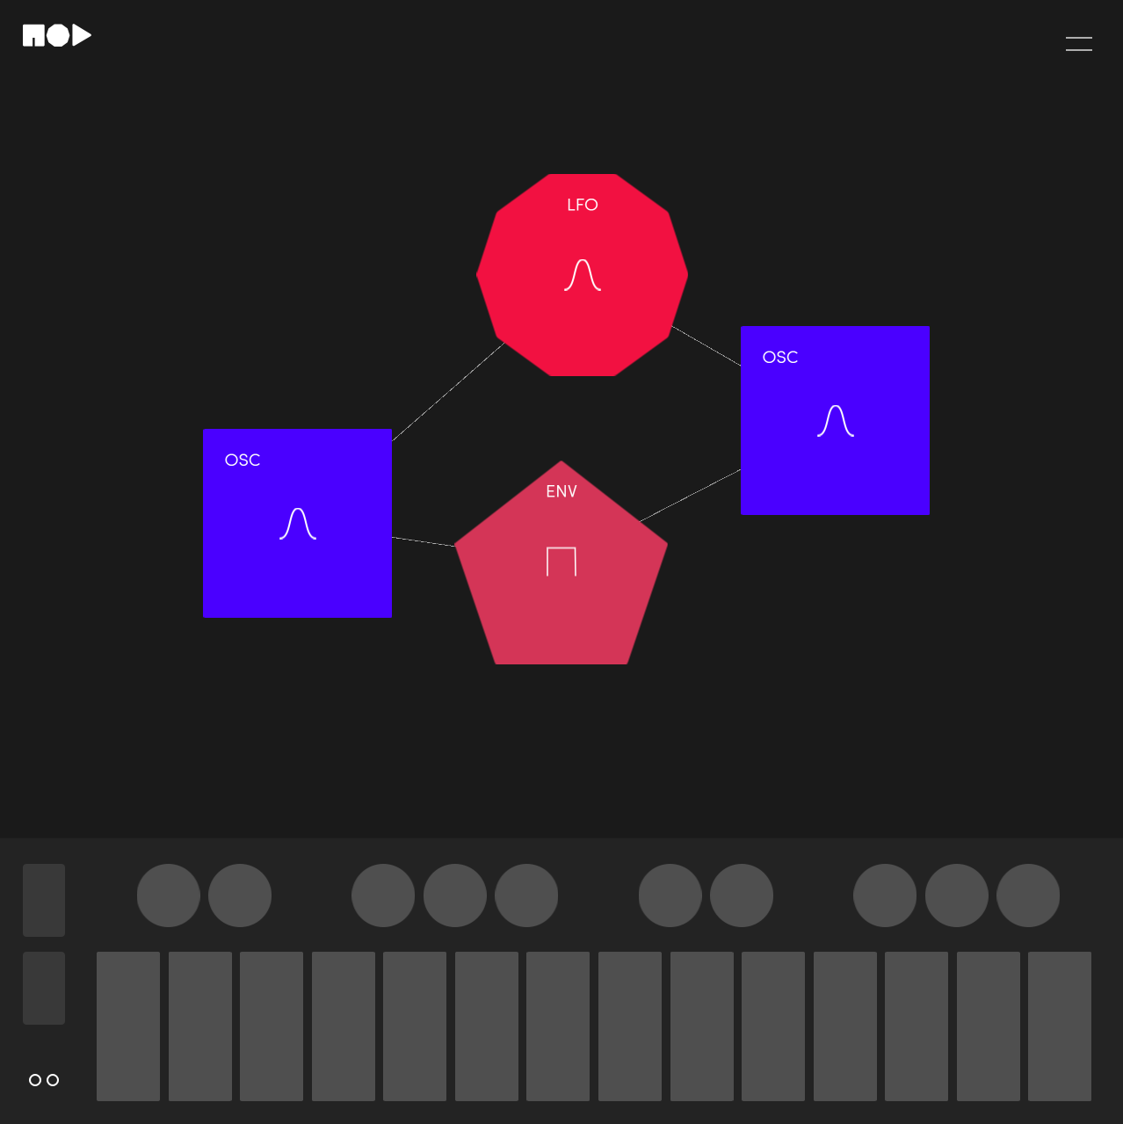

Existing Solutions
VCV Rack
websynths.com
mod-synth.io
And more….

Slide 4




Community Oriented
Open source
Free technologies
Simple to understand

Slide 5



Continuous Integration
Cypress testing
Prettier
Docker (?)

Slide 6



Technologies
Web Audio Api
Vue.js
Express
MongoDB
Node.js
{
“mod_1” : {
“osc”: { “type”: osctype, “freq”: freqval },
“Dist”: { “amount”: val, “oscurve”: curve },
“LFO”: { … }
},
“mod_2”: {...}
}

Slide 7
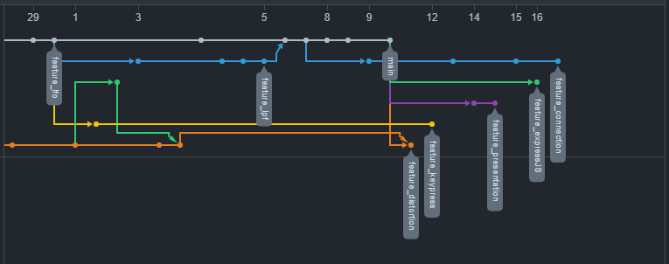
Version Control
Github as the remote repository
Using Github Projects for planning

Slide 8
Group Work
Miles - Vue, MongoDB, MIDI keyboard Module
Riley - Express, MongoDB, Distortion Module
Tristan - Oscillator Module, Filter Module, Connection Method

Slide 9
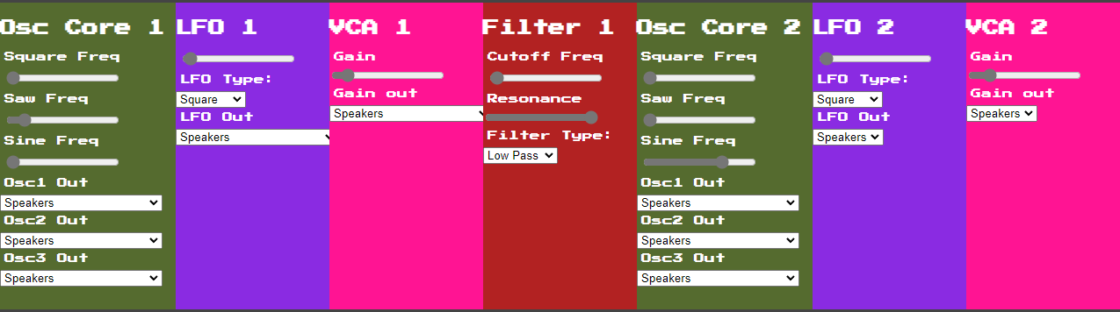
Demo

Slide 10
Potential Changes
Switch to Tone.js
Shrinking of scope: modular synth -> static synth

Slide 11
Questions?

